Slide 1
PWM Pulse Width Modulation
Expt. No- 9

Slide 2
PWM:
Pulse Width Modulation (PWM) is one method of reducing the perceived luminance in displays, which it achieves by cycling the backlight on and off very rapidly.
This generally means that at 100% brightness a constant voltage is applied to the backlight and it is continuously lit.
As you lower the brightness control the perceived luminance for the user reduces due to a number of possible controlling factors:

Slide 3
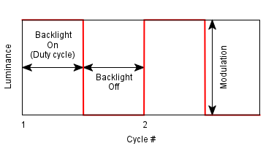
PWM:
https://www.divilabs.com/2014/12/pwm-pulse-width-modulation-using-matlab.html

Slide 4
PWM:
Pulse width modulation reduces the average power delivered by an electrical signal by converting the signal into discrete parts. In the PWM technique, the signal’s energy is distributed through a series of pulses rather than a continuously varying (analogue) signal.
How is a Pulse Modulation signal generated?
A pulse width modulating signal is generated using a comparator. The modulating signal forms one part of the input to the comparator, while the non-sinusoidal wave or sawtooth wave forms the other part of the input. The comparator compares two signals and generates a PWM signal as its output waveform.

Slide 5
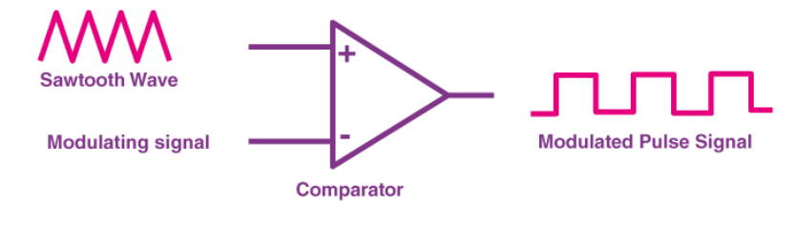
How is a Pulse Modulation signal generated?
If the sawtooth signal is more than the modulating signal, then the output signal is in a “High” state. The value of the magnitude determines the comparator output which defines the width of the pulse generated at the output.
Ref: https://byjus.com/physics/pulse-width-modulation/

Slide 6

Duty Cycle of PWM:
As we know, a PWM signal stays “ON” for a given time and stays “OFF” for a certain time. The percentage of time for which the signal remains “ON” is known as the duty cycle. If the signal is always “ON,” then the signal must have a 100 % duty cycle. The formula to calculate the duty cycle is given as follows:
The average value of the voltage depends on the duty cycle. As a result, the average value can be varied by controlling the width of the “ON” of a pulse.

Slide 7
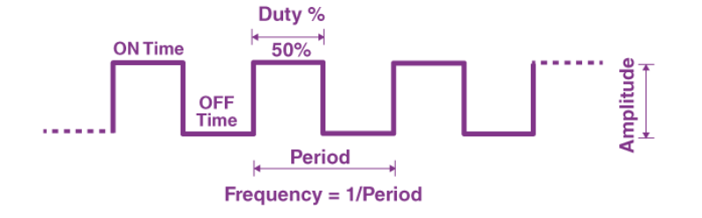
Frequency of PWM
The frequency of PWM determines how fast a PWM completes a period. The frequency of a pulse is shown in the figure above.
The frequency of PWM can be calculated as follows:
Frequency = 1/Time Period Time Period = On Time + OFF time

Slide 8
Output Voltage of PWM signal
The output voltage of the PWM signal will be the percentage of the duty cycle. For example, for a 100% duty cycle, if the operating voltage is 5 V then the output voltage will also be 5 V. If the duty cycle is 50%, then the output voltage will be 2.5 V.

Slide 9
Types of Pulse Width Modulation Technique:
There are three conventional types of pulse width modulation technique and they are named as follows:
Trail Edge Modulation – In this technique, the signal’s lead edge is modulated, and the trailing edge is kept fixed.
Lead Edge Modulation – In this technique, the signal’s lead edge is fixed, and the trailing edge is modulated.
Pulse Center Two Edge Modulation – In this technique, the pulse center is fixed and both edges of the pulse are modulated.

Slide 10
What are some applications of Pulse Width Modulation?
Owing to its high efficiency, low power loss and the ability of the PWM technique to precisely control the power, the technique is used in a variety of power applications:
They are used in telecommunication for encoding purposes.
They are used in Audio/Video amplifiers.

Slide 11
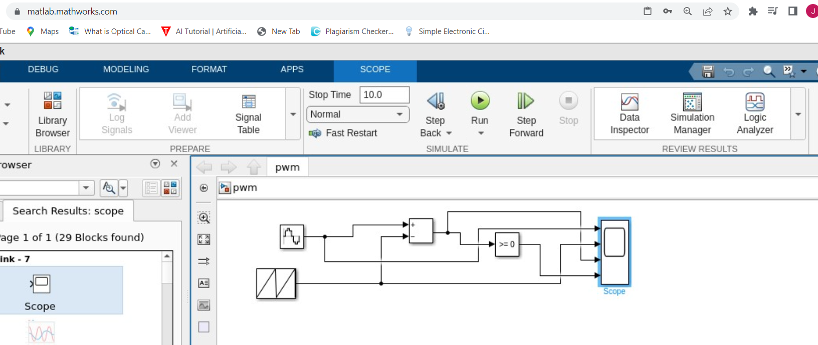
PWM in MATLAB Simulink:

Slide 12
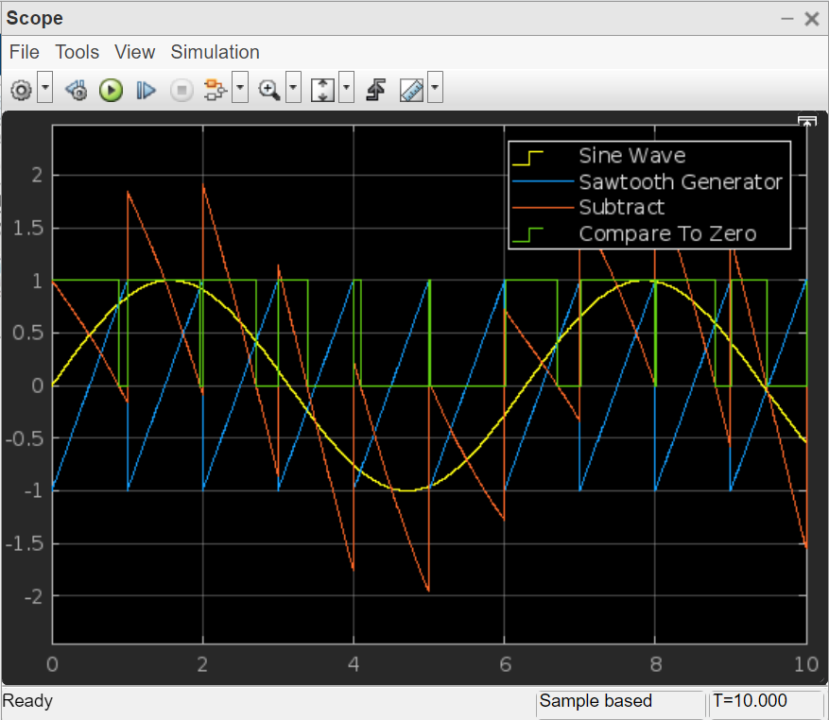
PWM:

Slide 13
PPM Pulse Position Modulation
Expt. No- 10

Slide 14
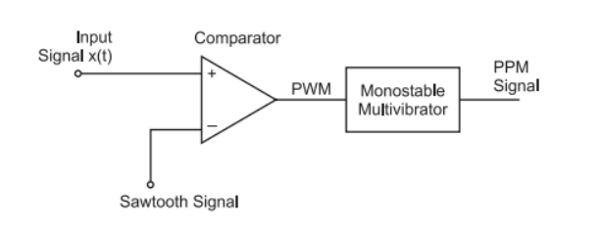
PPM:
[1]

Slide 15
PPM:
Pulse Position Modulation (PPM) is an analog modulating scheme in which the amplitude and width of the pulses are kept constant, while the position of each pulse, with reference to the position of a reference pulse varies according to the instantaneous sampled value of the message signal.
The transmitter has to send synchronizing pulses (or simply sync pulses) to keep the transmitter and receiver in synchronism. These sync pulses help maintain the position of the pulses. The following figures explain the Pulse Position Modulation.

Slide 16
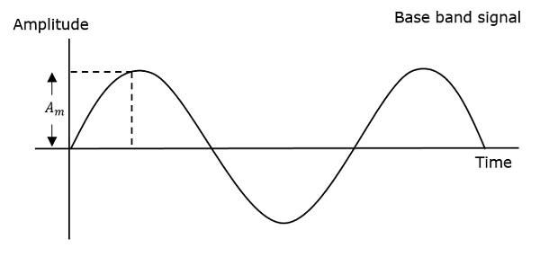
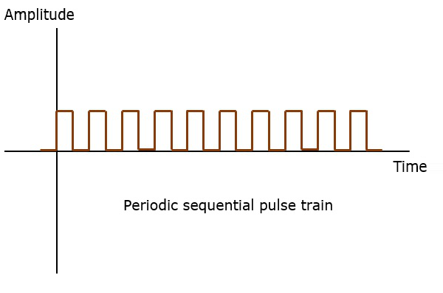
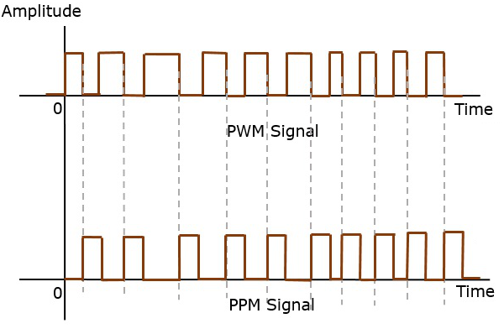
PPM waveform:
[4]

Slide 17
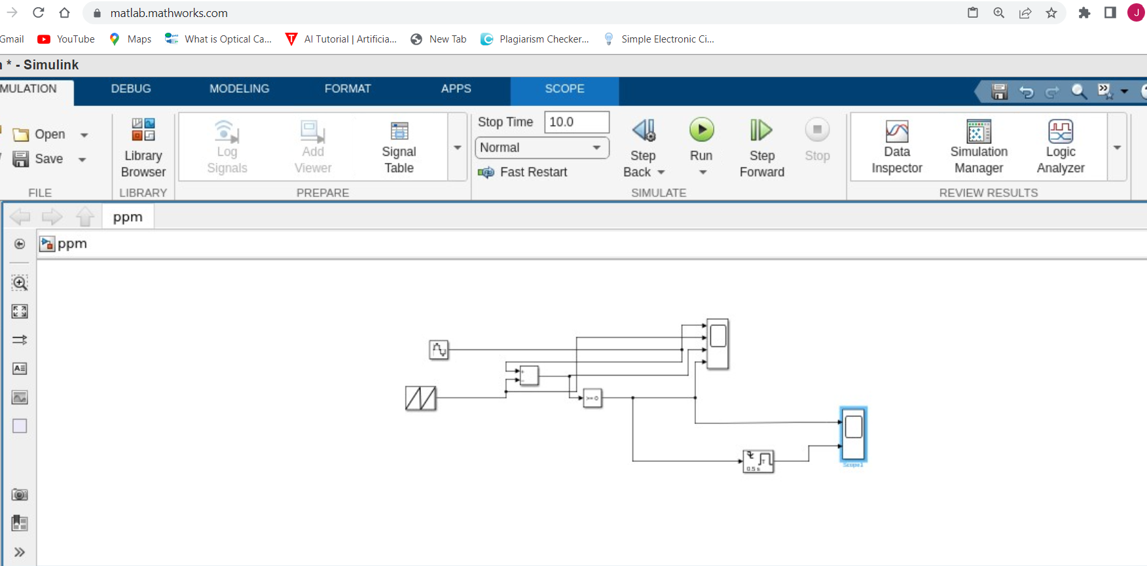
PPM in MATLAB Simulink:

Slide 18
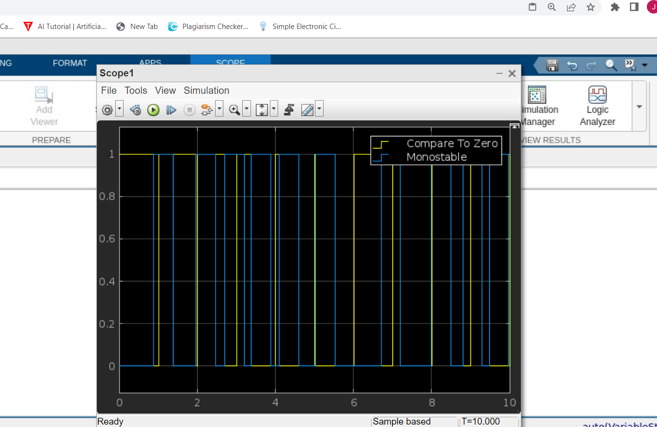
PPM Output:

Slide 19
PPM:
Pulse position modulation is done in accordance with the pulse width modulated signal. Each trailing of the pulse width modulated signal becomes the starting point for pulses in PPM signal. Hence, the position of these pulses is proportional to the width of the PWM pulses.
Advantage
As the amplitude and width are constant, the power handled is also constant.
Disadvantage
The synchronization between transmitter and receiver is a must.

Slide 20
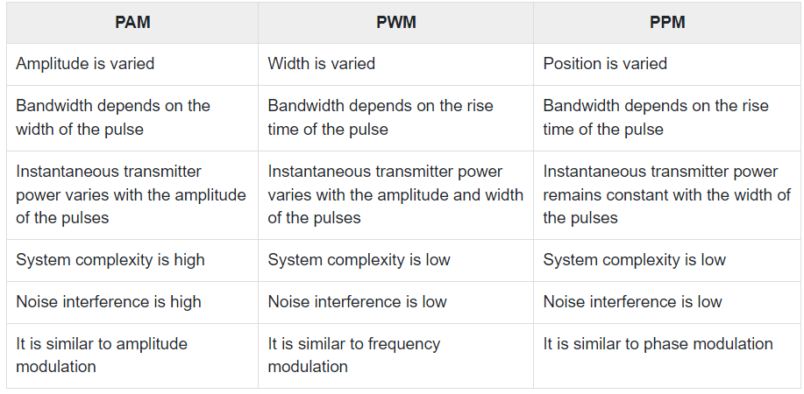
Comparison:
Ref:https://www.tutorialspoint.com/principles_of_communication/principles_of_communication_analog_pulse_modulation.htm#:~:text=Pulse%20Position%20Modulation%20(PPM)%20is,value%20of%20the%20message%20signal.

Slide 21
References:
[1] https://www.divilabs.com/2014/12/pwm-pulse-width-modulation-using-matlab.html
[2] https://www.youtube.com/watch?v=McVUmm9vqsc
[3] https://www.youtube.com/watch?v=pT4KFfI2Kq8
[4]https://www.tutorialspoint.com/principles_of_communication/principles_of_communication_analog_pulse_modulation.htm#:~:text=Pulse%20Position%20Modulation%20(PPM)%20is,value%20of%20the%20message%20signal.

